Slide 1
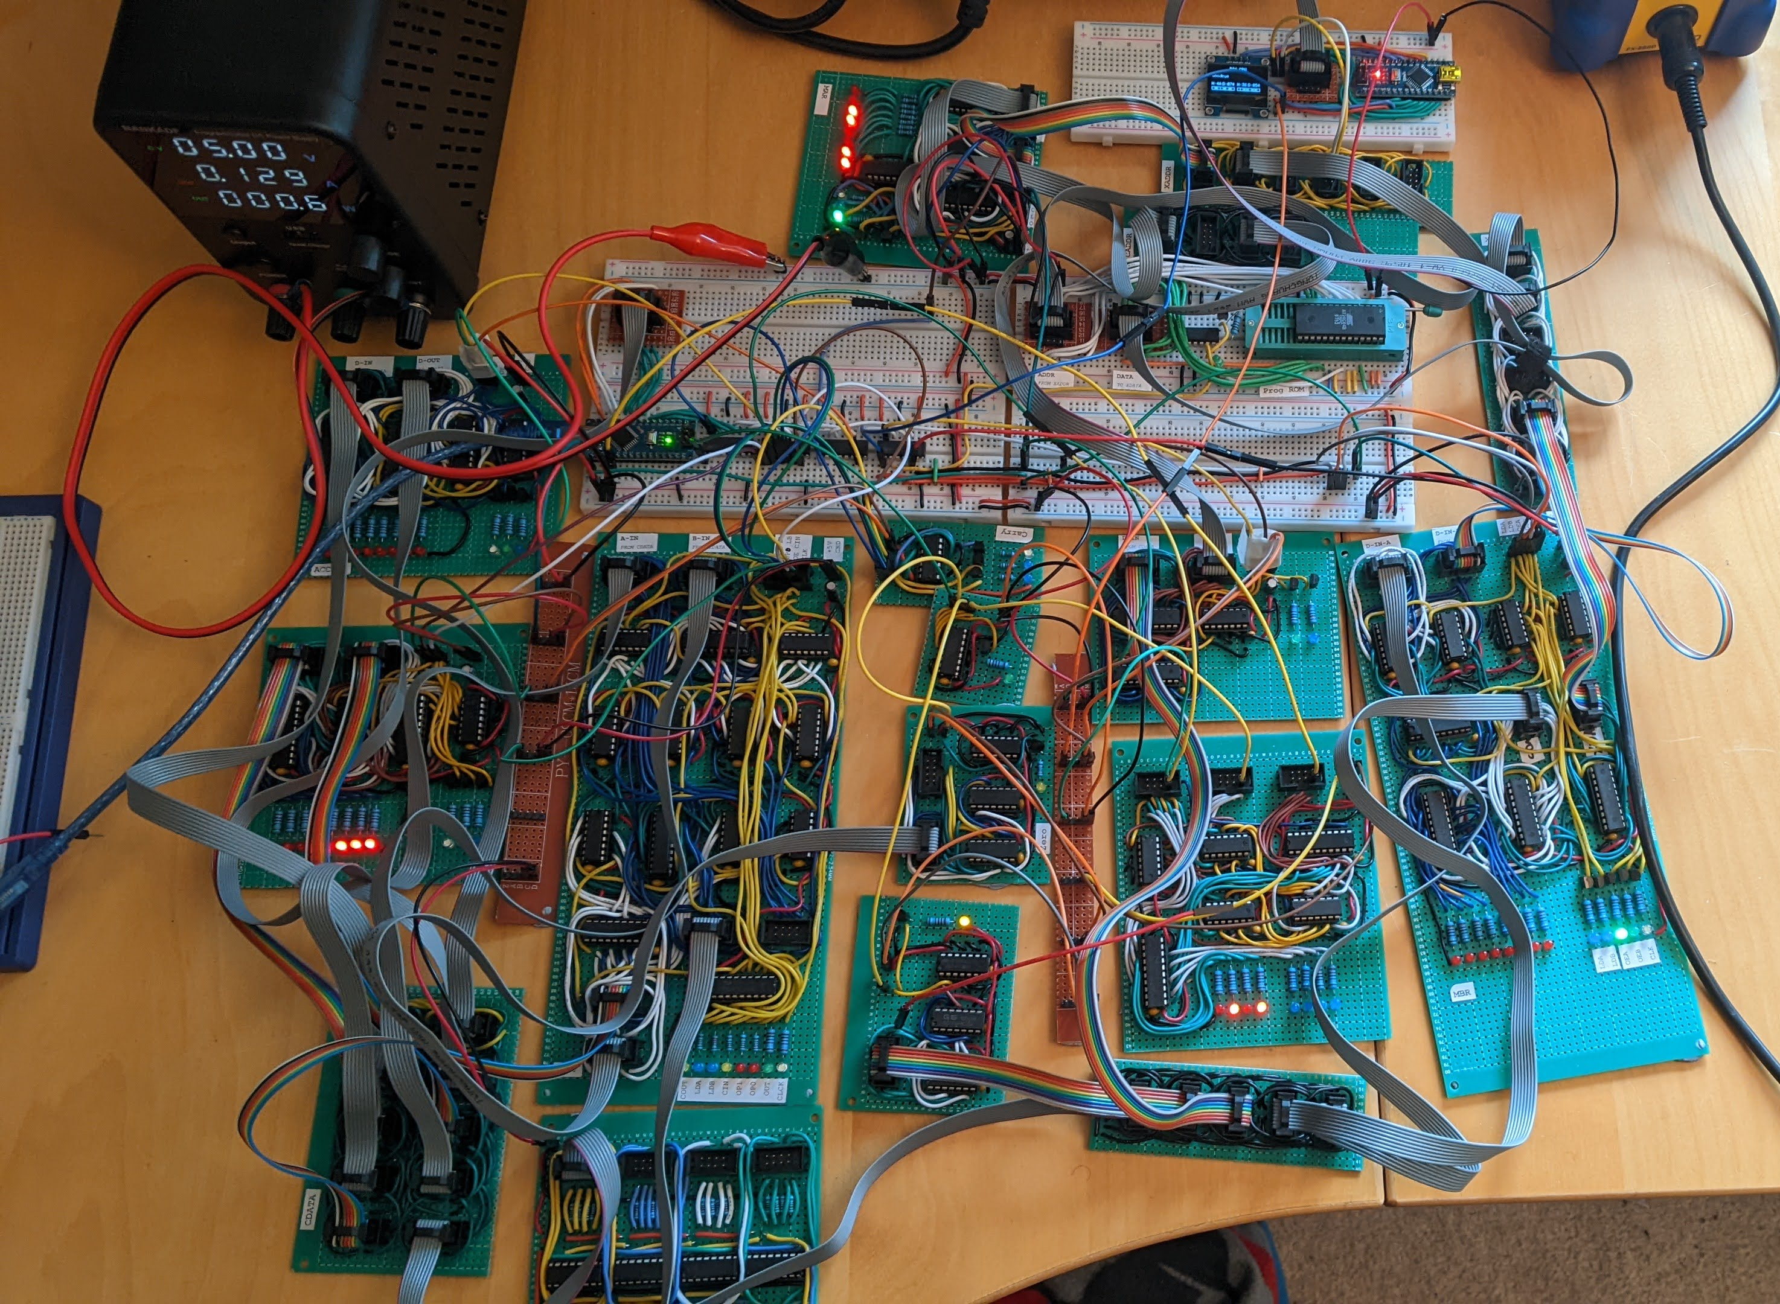
Memory Mapped Output
MAR
Control Unit
XADDR
CADDR
XDATA
Accumulator
Program ROM
ALU
MBR
X Register
Carry
Z- Selection
Bus Bridge
Zero (ALU)
CDATA
Zero (CDATA)
CDATA
Debugging Display

